Slide 1

Home Safety and Security System Using IOT
Student Name : Pingili Manishreddy
Roll Number: 18241A04S3

Slide 2
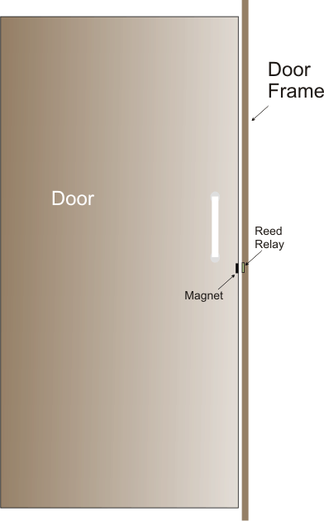

Objective:
The main objective of the project is to implement the home safety and security system with the following features:
- Monitoring and detection of leaks in LPG gas
- Unauthorized opening of door/window

Slide 3
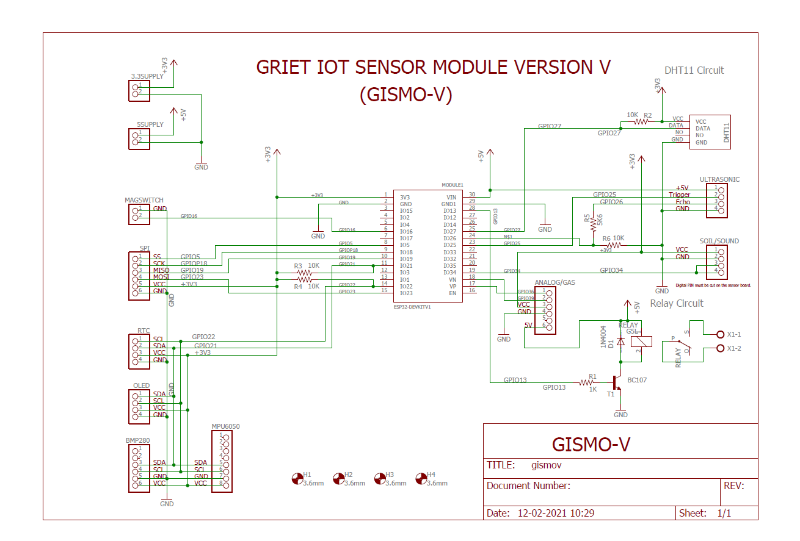
Block Diagram:

Slide 4
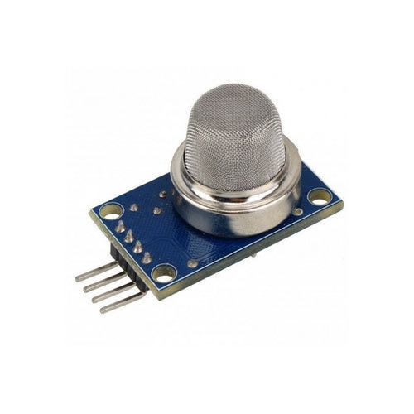
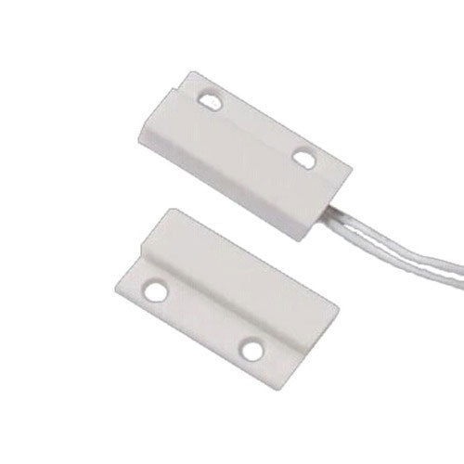
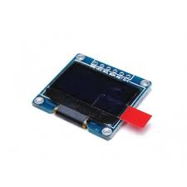
Hardware Requirements:
The hardware for the project consists of:
GISMO-V board with:
o ESP32 dual-core 32-bit processor with Wi-Fi and BLE
o MQ6 sensor module
o Magnetic swich assembly
o 0.96” OLED display with 128x64 resolution
MQ6 Sensor
Magnetic Switch
OLED Display

Slide 5
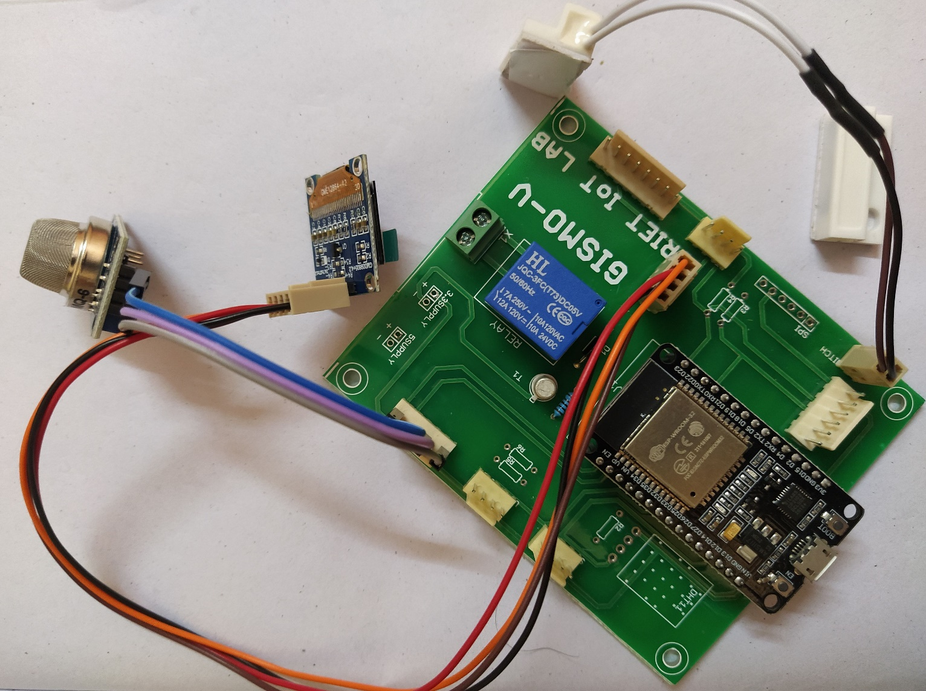

Slide 6
Cloud Platform:
In this project we are going to use Google’s firebase as cloud database. It is a No-SQL database in which data is stored as Key-Value pairs .
To access the database the following credentials are required
Host URL
-Database authentication key
These credentials are put in to the ESP32 firmware to access the Google Firebase.
The keys used to store the parameter values in the project are:
- IOTLAB/HSSS/Gas_Leak
- IOTLAB/ HSSS/Window_Open

Slide 7
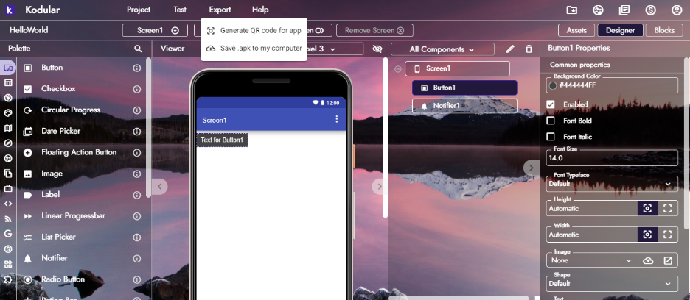
Mobile App:
The Kodular rapid mobile app development utility is used for the development of mobile app. The utility has two modes, a Developer mode and a Blocks mode. Different functional blocks are available in developer mode ,they are – User Interface, Sensors, Connectivity, Firebase, and so on.
In the Blocks mode, a timer with timing set to two seconds will fetch the LPG gas concentration and magnetic switch status values from the Firebase database and fill it in the appropriate place in the UI.
To access the Firebase dataset its credentials will be placed in the Firebase component of the Kodular app .

Slide 8
Results and Conclusions:
With the help of MQ6 sensor and magnetic switch we monitored the leakage in LPG gas and also window/door open status.
We can get notified with the help of the mobile app.

